Slide 1
NRMP Policy: Webinar for SMS Fellowship Programs
Josephine Gaabucayan - Director, Policy and Compliance
Laurie Curtin, PhD - Chief Operating Officer
December 12, 2024
Notes:
Welcome everyone and thank you for taking time out of your busy schedules to be with us today. I’m Laurie Curtin, COO here at the NRMP. You’ve already heard from Joy Gaabucayan, the NRMP Director of Policy and Compliance, and we are joined by our trusty compliance analysts to share some new information and provide some refreshers on Match policy so you all are ready for the 2025 Fellowship Match season.

Slide 2
Agenda
Why Policy Matters
New Policies/Process for SMS 2025
Policy Refreshers
Bumps in the Road
Updates and Goings-On
Q&A
Reproduction of slides and data prohibited without permission from the NRMP
Notes:
Here is our agenda for today. We’ll start by framing why Match policy matters and how we hope it strengthens the Match experience for all participants. We’ll then move into some new policy language and match process for next year’s Fellowship Matches, review some of the more relevant parts of the Match Agreements to make sure you are aware of key policy clauses, and then walk you through the steps we take to support programs when bumps in the road to fellow onboarding may occur. We will close with a few updates and goings-on we want you to know about. There should be time for questions but certainly you can drop your inquiries into the Q&A feature as we move through the slides – our analysts will do their best to respond in real time.

Slide 3
Outlines participants’ unique roles and responsibilities
Establishes a binding commitment to enter training
Prohibits coercive questioning and pressure about ranking
Protects the confidentiality of rank order lists
Incorporates procedures for terminating a binding commitment or investigating and alleged breach of policy
NRMP Policy
Central to processing a Match
Reproduction of slides and data prohibited without permission from the NRMP
Notes:
The NRMP’s Match policies support the organization’s long-standing reputation for maintaining a matching program that is fair, transparent, equitable, efficient, and reliable by providing guidance on Match participation and protecting the rights and responsibilities of all constituents to receive and promote professional and ethical behavior. How does policy do that for the matching process specifically?
The Agreements
Define each participant group and outline their eligibility for Match participation
Shield the ranking preferences and ranking decisions of each participant from coercion or exposure
Lock in the commitment of each participant to honor the Match outcome, thereby ensuring continuity of training across the transition
Authorize the evaluation of behaviors and/or actions that could compromise the integrity of the match

Slide 4
NRMP Policy
Require disclosure of complete, timely, and accurate information
Mandate ethical and professionally responsible behavior
Foster transparency, equity during the interview invitation and acceptance period
Authorize transmission of Match information for research purposes
Also central to maintaining equity and transparency throughout the transition to residency
Reproduction of slides and data prohibited without permission from the NRMP
Notes:
To ensure a transition that is as seamless as possible, the NRMP’s Match policies also provide structure to aspects of the transition that are not directly focused on matching. The NRMP’s Agreements
Require disclosure of complete, timely, and accurate information – not just an applicant’s education or prior training but also about possible legal experiences; for programs, it’s about contacts and onboarding requirements
Mandate ethical and professionally responsible behavior at all phases – no logging in to someone else’s profile and changing their ranks; no coercion; no plagiarism
Foster transparency, equity during the interview invitation and acceptance period – encourage and allow time and space for applicants to consider the programs with which they want to meet
Authorize transmission of Match information for research purposes – build necessary partnerships to combine data/understanding to better address issues related to application, ranking, matching, training, career.

Slide 5
Why Policy Matters
PARITY | EQUITY | ACCOUNTABILITY
Participants should follow the same timelines and processes for the Match | Participants should have access to an impartial venue for matching preferences | Participants should be responsible for ethical and professionally responsible behavior
Reproduction of slides and data prohibited without permission from the NRMP
Notes:
So why does Policy Matter? In the end, NRMP Policies help foster parity, equity and accountability during the transition. We believe...
Participants should be able to navigate the Match with the same rules and timelines
Participants should have access to a matching venue that is impartial and driven solely by individual preferences
Participants should treat each other and the Match with integrity and professionalism
As we move through today’s presentation, we hope you will keep these objectives in mind and recognize that the policies are intended to guide and support all individuals through the transition.

Slide 6
Agenda
Why Policy Matters
New Policies/Process for SMS 2025
Policy Refreshers
Bumps in the Road
Updates and Goings-On
Q&A
Reproduction of slides and data prohibited without permission from the NRMP
Notes:
So let’s pivot to a look at the Specialties Matching Service, or SMS, and new policy language for Matches opening in 2025.

Slide 7
Specialties Matching Service
Med & Peds Specialties
Dec 4 Match Day
Rehabilitation Medicine
Dec 18 Match Day
Psychiatry Specialties Jan 8 Match Day
Sports Medicine Jan 8
Match Day
Reproduction of slides and data prohibited without permission from the NRMP
Notes:
We’d like to acknowledge the few Fellowship Matches that remain open for July 2025 appointments. The last of this year’s Matches are underway and set to close out in December and early January for July 2025 appointments. They include...

Slide 8
Specialties Matching Service
Growth and Expansion
2025 Appointments:
Interventional Cardiology (Medicine and Pediatrics Match)
2026 Appointments:
Hematopathology
Molecular Genetic Pathology
Bone and Soft Tissue Pathology
Reproduction of slides and data prohibited without permission from the NRMP
Notes:
And we are always excited to welcome new specialties to the SMS family. This year, Interventional Cardiology joined the Medicine and Pediatrics Fellowship Match, and we are pleased to announce that three new Pathology subs are joining the SMS this upcoming year for July 2026 appointment! Hematopathology, Molecular and Genetic Pathology, and Bone and Soft Tissue Pathology will join Forensic Pathology to create a combined Fellowship Match (the timeline for that Match occurs Feb – April).
Now let’s turn attention to some new policy language in the Match Agreements.

Slide 9
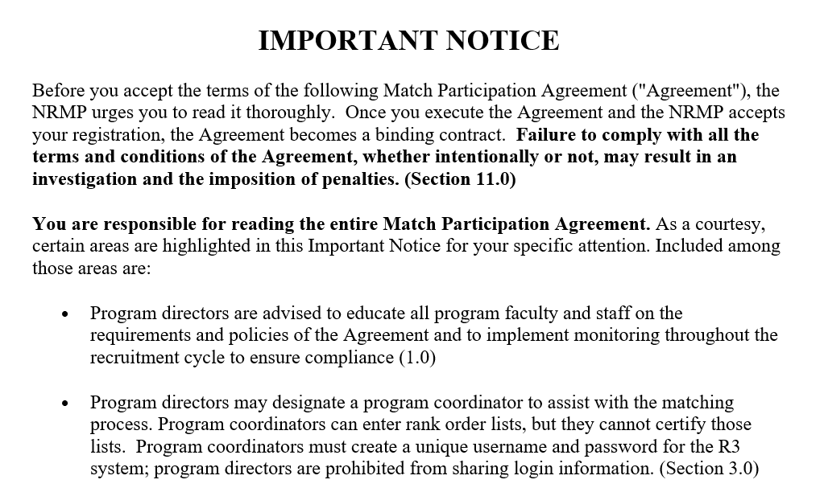
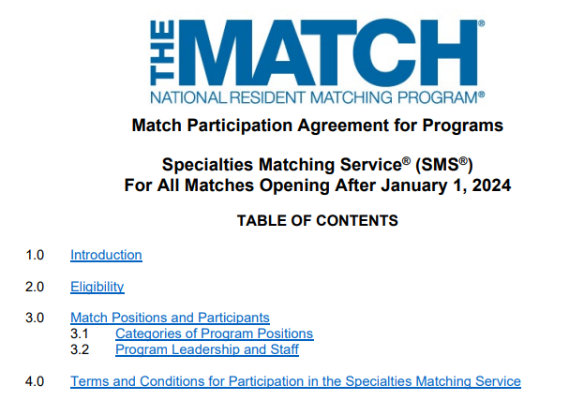
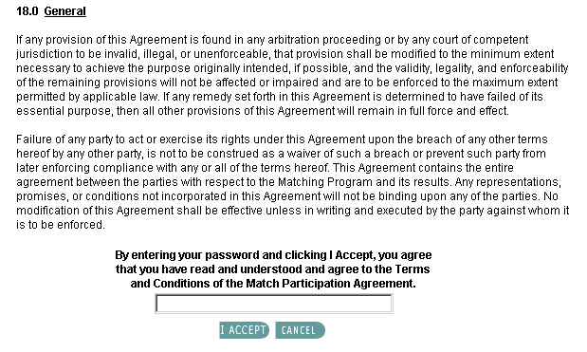
Specialties Matching Service
Reproduction of slides and data prohibited without permission from the NRMP
Notes:
NRMP policies are a critical part of the Match experience, and as we’ve covered, the Match Participation Agreements that govern the NRMP Matching Program outline participant roles and responsibilities for Match participation. In recent years, the Match Agreements have been modernized and provide better flow, more targeted content, and increased guidance for all Match participants.
As part of the registration process, participants are provided with an Important Notice page that identifies key policies. Participants then are prompted to read the entire Match Participation Agreement and attest that they will comply with NRMP policies and adhere to the outcome of the Match. When the Match registration process is complete, the MPA becomes a binding contract.

Slide 10
Specialties Matching Service
NEW! DIO Attestation and Oversight
Section 2.0 INSTITUTION LEADERSHIP (MPA for Institutions)
Section 2.1 Institutional Official
...9. Agree to provide oversight of unaccredited fellowship programs in the R3 system by monitoring their participation in and compliance with the rules of the Match. Unaccredited programs for which the institutional official does not or cannot assume Match participation oversight will not be permitted to participate in the Match.
Reproduction of slides and data prohibited without permission from the NRMP
Notes:
There is some new language going into the Match Agreements for Matches opening after January 1. The NRMP has heard from institutional officials over time with questions regarding the “oversight” clause it the SMS Match Agreements that references unaccredited fellowship programs and what it means to “govern” those programs. This past summer, NRMP staff worked to clarify that language in the Match Agreements. Specifically, the NRMP’s expectation of IOs with respect to “oversight” of unaccredited fellowships is to ensure that all programs, regardless of accreditation status, understand and comply with the rules of the Match and provide the necessary information to the institution (e.g., program participation), the NRMP (e.g., accurate quota) and applicants (e.g., complete timely and accurate information about eligibility and onboarding). We hope this provides an improved sense of regulation and that IOs can better determine what oversight and governance of unaccredited programs means for them.
What about guidance for unaccredited fellowship programs in the SMS?

Slide 11
Specialties Matching Service
NEW! Unaccredited Program Eligibility
Section 3.0 PROGRAMS IN THE SMS (MPA for Programs)
Section 3.1 Eligibility
1. Be accredited by the ACGME or another accrediting or certifying body acceptable to NRMP;
a. If not ACGME-accredited, be affiliated (e.g., shared resources, shared faculty for fellow training/supervision, program letter of agreement) with an ACGME-accredited program in the primary discipline or ACGME-accredited institution;
Programs not affiliated with an ACGME-accredited program in the primary discipline or an ACGME-accredited institution are eligible for the Match with NRMP Institutional Official attested oversight of program participation in and compliance with the rules of the Match.
Reproduction of slides and data prohibited without permission from the NRMP
Notes:
The NRMP also has added clarity to language in the SMS MPAs to help unaccredited fellowship programs better understand their Match eligibility. Specifically, the NRMP has added language that provides examples of how an affiliation might be established or defined between unaccredited fellowship programs and the ACGME-accredited program in the primary discipline. Language also now exists to remind unaccredited programs of the role the IO plays in tracking their participation in and compliance with the rules of the Match – this language at the bottom of the screen is meant to reinforces what we just shared with you about IO oversight and ensuring unaccredited fellowship programs understand and comply with Match participation actions and policies.

Slide 12
Specialties Matching Service
NEW! Report of Violations
Section 11.0 VIOLATIONS (MPA for Programs)
Section 11.2 Eligibility
Programs should report to NRMP any known or suspected violation(s) of this Agreement within one year of learning about the suspected violation(s). If the known or suspected violation(s) pertains to a matched applicant, the violation must have occurred no later than the 45th day after the start date of the relevant appointment contract.
Reproduction of slides and data prohibited without permission from the NRMP
Notes:
As a reminder the NRMP has long had the discretion to determine whether to investigate a reported and alleged breach of the Match Agreement. What has been added to the SMS Match Agreements is new language recommending a timeframe for the reporting of suspected violations. Specifically, programs are now asked to report alleged violations within one year of learning about the alleged violation. The alleged violation also must have occurred during the first 45 days from the date specified in the appointment contract, as that is the point at which the regulation of a Match commitment by the NRMP concludes. The NRMP has seen an uptick in requests from applicants and programs to investigate alleged breaches of Match policy that either happened in a prior Match cycle or fall outside the purview of the NRMP’s oversight. This language hopefully makes clear when the NRMP can get involved should a program report it in a timely manner.

Slide 13
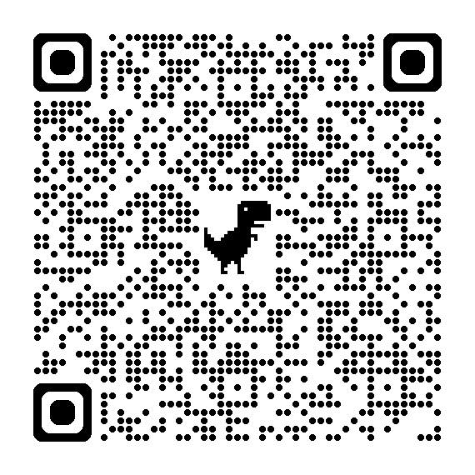
NEW! SMS Process Change - January 2025
Program Directors (PD) and Institutional Administrators (IA) to activate programs for participation in the Match
IO activates Institution
IO activates programs and quota rolls over from prior year
PD registers and verifies program information and quota
Current Process
New Process (Optional)
IO activates institution
IA or PD activates program and verifies program quota
IO completes change approval of program activation
Reproduction of slides and data prohibited without permission from the NRMP
Notes:
With policy updates covered, we want to pivot to a process change that the NRMP is implementing for SMS Fellowship Matches that open after January 1, 2025.
Specifically, starting January 17, fellowship program directors and institutional administrators will have the ability to activate programs for participation in the applicable Fellowship Match. In the graphic here, we outline the current process (walk through the current process). So, the Institutional Official (IO) traditionally has been required to activate both the institution and all the programs for Match participation in the NRMP’s Registration, Ranking, and Results® (R3®) system. With the new functionality, or New Process in the graphic, IOs will continue to activate the institution but will now have the option to direct the Institutional Administrator (IA) or Program Directors (PDs) to activate their programs. This allows the IO the ability to ensure the PDs confirm their participation in the Match at the program level and it also allows PDs to update their program quota in a more timely and efficient manner. Program coordinators can see the program’s status in the R3 system but cannot activate programs.
This QR Code takes you to the announcement we posted this week on the NRMP website. The announcement includes a graphic that provides a bit more of a drill down into the enhanced R3 system capabilities for PDs and IA, and we hope you’ll take a moment to review it. If you have questions, you can always reach out to the NRMP at support@nrmp.org

Slide 14
Agenda
Why Policy Matters
New Policies/Process for SMS 2025
Policy Refreshers
Bumps in the Road
Updates and Goings-On
Q&A
Reproduction of slides and data prohibited without permission from the NRMP
Notes:
I’m now going to turn it over to Joy now who will take us through a review of highlights from the Match Agreements that are critical for programs. Joy?

Slide 15
Policy Refresher – Common Pitfalls
Application and Interview Processes
Program offers more interview slots than available and requires applicants to respond in less than 48 hours
Program fails to provide complete, timely, and accurate information to applicants
Program asks applicants where else they applied and/or their ranking intentions
Matching Processes
Program fails to honor the binding commitment
Program offers a matched position prior to receiving a waiver from NRMP
Program offers a position to an applicant matched to a concurrent year position in another program
Reproduction of slides and data prohibited without permission from the NRMP
Notes:
What we’d like to focus on in this section are the parts of the Match Participation Agreement that are particularly important for programs to be aware of because they reflect conditions that often pose challenges for programs across the application, interview, and matching processes. Common pitfalls include...
Let’s examine the sections of the Match Agreement that address these pitfalls to understand what the language says, what it means for programs, and ways to avoid noncompliance.

Slide 16
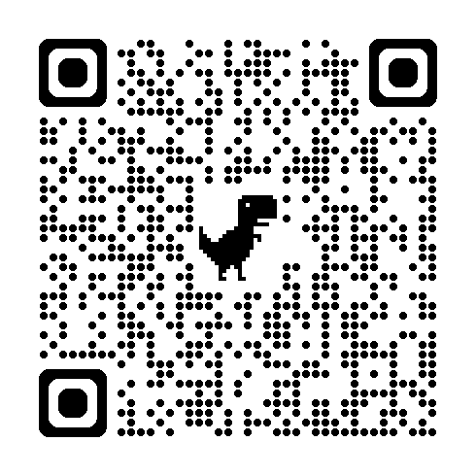
Policy Refresher – Professionalism
Section 6.1 Duty to Act in an Ethical and Professional Manner
All Match participants are required to conduct their affairs in an ethical and professionally responsible manner. The duty under this Agreement:
1. Extends throughout the application, interview, and matching processes; and
2. Through the 45th day following the start date of training as listed in the appointment contract; or
3. Upon conclusion of any NRMP-related waiver review, violation investigation, or appeal process.
Match Code of Conduct for Programs
Reproduction of slides and data prohibited without permission from the NRMP
Notes:
The NRMP wants and encourages all Match participants and stakeholders to move through the transition with integrity and professionalism. There is language in the SMS Match Agreements that references ethical behavior, and it’s found in Section 6.1 of the MPA for Programs. It reads....
The QR Code takes you to the Match Code of Conduct for Programs, a document that outlines actions programs and ALL members of their recruitment team should take to ensure applicants are treated equitably and respectfully. We hope you will take a moment to read the Code and use it as a guide during the Match!

Slide 17
Policy Refresher - Interviews
Section 6.2 Interview Period Policy
During the recruitment phase programs shall:
Extend interview offers that equal, but not exceed, the total number of available interview slots
Provide applicants no less than 48 hours to accept or reject an interview invitation
Apply reasonable measures of notification (e.g., one-to-two weeks’ notice) when needing to cancel or reschedule an interview
Reproduction of slides and data prohibited without permission from the NRMP
Notes:
In 2023, the NRMP introduced a new policy around the interview period. The policy is intended to bring clarity and guidance to the interview component of the transition to fellowship and create accountability for those applicants or programs who reportedly engage in unprofessional practices.
During the recruitment phase, programs are expected to extend only the total number of interview slots available and not exceed that number by overbooking applicants to interview. An example of this is when a program sends out more than one interview invitation for a single interview slot, as a first-come-first serve practice. ​It is also important to note that programs placing applicants on a waitlist may only extend one waitlist offer at a time.
The interview period policy also stipulates that applicants invited to interview shall be provided 48 hours to accept or reject that interview offer. This provides reasonable time for applicants to consider their options and also respects all applicants’ current clinical and academic scheduled obligations.
And finally, programs must provide a reasonable timeframe to notify applicants of cancellations or interview reschedules regardless of virtual or in-person interviews. It is equally important to note that applicants are also held accountable to the interview policy, and applicants must also provide reasonable measure of notification to the program when needing to cancel or reschedule an interview. ​
While the interview season may not be as intense or chaotic for fellowship Matches, we share it here as a reminder of the need for applicants and programs alike to minimize any unnecessary stress associated with recruitment.

Slide 18
Policy Refresher – Accurate Information
Section 6.3 Complete, Timely, and Accurate Information
Programs must
1. Ensure the completeness, timeliness, and accuracy of all information provided to applicants.
2. Provide a copy of the appointment agreement that matched applicants will be expected do sign (or the agreement currently in use) prior the applicable Rank Order List Certification Deadline.
3. Provide all institutional and program policies regarding eligibility for appointment.
Reproduction of slides and data prohibited without permission from the NRMP
Notes:
A policy that can trip up programs is the requirement for programs to provide applicants with complete, timely, and accurate information. This information includes all written, electronic, and verbal information provided to applicants throughout recruitment, the onboarding cycle, and through the 45th day following the appointment start date as well as all written electron and verbal information provided to the NRMP. Programs must notify applicants of any material changes to appointment agreements, and reveal all pertinent institutional policies (e.g., visa eligibly, onboarding screenings) so that applicants can make fully informed decisions about their ranking preferences. Programs are required to provide this information to all applicants interviewed in advance of the applicable rank order list certification deadline. It is recommended that programs have a method of documenting that they have provided all pertinent information to applicants.
Note that this complete, timely and accurate information policy does not apply only to programs. Applicants also are required to provide complete, timely, and accurate information to programs, regarding either their eligibility status to enter training, or any information that could be pertinent to a program’s decision to rank the applicant.

Slide 19
Policy Refresher – Persuasion
Section 6.5 Restrictions on Persuasion
Programs cannot
1. Request applicants reveal names, specialties, geographic locations, or other identifying information about programs to which applicants have or may apply or have signaled.
2. Request applicants reveal information pertaining to the interviews offered, accepted, declined, or attended. Programs cannot request applicants’ ranking intentions.
3. Solicit verbal or written statements implying a commitment to rank the program.
Programs may voluntarily communicate that an applicant is viewed favorably and will be ranked. Ensure all recruitment team members are aware of policies.
Reproduction of slides and data prohibited without permission from the NRMP
Notes:
The requirement for complete, timely and accurate information outlines what programs have to communicate to and talk about with applicants. Let’s touch base on what programs cannot talk about. The restrictions on persuasion section of the MPA explicitly states that programs cannot request applicants to reveal ranking preferences, preference signals, or the names, specialties, geographic locations, or other identifying information about programs to which they have or may apply. The same holds true with respect to interview invitations accepted, declined, or attended.
As mentioned earlier, the Match strives to maintain a fair process for all parties. Limiting questions about other programs an applicant may be considering protects and respects an applicant’s right to privacy and minimizes undue or unwarranted pressure. In addition, programs are encouraged to submit rank order lists that are based on applicants’ credentials and goodness of fit for the program rather than the likelihood of the applicant ranking the program.
How might this work in an interview? A program cannot ask about other programs to which the applicant is applying. A program can, however, ask applicants why they are interested in their specific program or specialty or a particular town or region. And applicants may volunteer information about other programs if they choose to do so. Again, we encourage questions that minimize undue pressure and rather focus on fit with the program. Where else an applicant is applying is not considered a primary determinant of the applicant’s fit in a program.
Programs may voluntarily communicate to an applicant that they are viewed favorably and will be ranked. Applicants and programs are free to communicate with each other within the context of the restrictions on persuasion up to and until the Rank Order List Certification Deadline.
Please be sure all institution staff who participate in interviews, decision-making, or who can speak for the program are aware of policies. Restrictions on persuasion requirements hold true AFTER the Match has concluded. Some programs issue post-Match surveys. It’s fine to do that, but there should be no questions about how or where applicants placed your program on their rank order list.

Slide 20
Why Policy Matters
New Policies/Process for SMS 2025
Policy Refreshers
Bumps in the Road
Updates and Goings-On
Q&A
Reproduction of slides and data prohibited without permission from the NRMP
Notes:
So, what happens when programs hit bumps in the road with respect to matched applicants and the NRMP? Let’s take a look.

Slide 21
Binding Commitment
Section 8.0 Binding Commitment
Upon conclusion of the applicable Fellowship Match, programs:
1. Are in binding commitment with an applicant and must offer an appointment as matched or offered.
2. Must begin training applicants on the start date specified in the appointment contract with the intent to complete the applicant’s training.
Applicant Match History
Determine whether an applicant is eligible for appointment prior to offering interviews or has a waiver/violation history.
Available in the R3 system year-round.
Applicants with no prior NRMP activity will not appear in search results.
Reproduction of slides and data prohibited without permission from the NRMP
Notes:
A cornerstone of the NRMP Matching Program is the binding commitment that is created when a match occurs. The Match Participation Agreements stipulate that applicants and programs enter into a binding commitment when they are matched. The binding commitment holds for 45 days from the date specified in the appointment contract. Neither applicants nor programs can terminate a binding commitment during the first 45 days absent a waiver from the NRMP. The binding commitment must be honored by all parties.
The Match Participation Agreements also prohibit a program from discussing, interviewing for, or offering a position to an applicant who has obtained a concurrent year position in another program through the NRMP or who is ineligible as the result of a denied waiver or a confirmed violation. It is crucial for programs to ensure that the applicants they are considering are eligible to Match and do not have a concurrent Match commitment or violation sanction.
The Applicant Match History tool available in the R3 system was designed to assist program directors, program coordinators, and institution staff in determining whether an applicant has a concurrent match commitment and/or was the subject of a waiver review or violation investigation. This information is accessible throughout the year, regardless of whether the Match in which the institution participates is open or closed.

Slide 22
Binding Commitment - Waivers
Section 9.0 Waiver or Deferral of Match Results
“… Neither applicants nor programs may release each other from the binding Match commitment. A waiver or deferral of the binding commitment may be requested only from the NRMP. The NRMP has sole discretion to grant or deny a requested waiver or deferral. The terms of the Waiver and Deferral Policy, which can be found on the NRMP website, are incorporated herein and binding upon all Match participants..…”
Reproduction of slides and data prohibited without permission from the NRMP
Notes:
It's important to note that neither an applicant nor a program can release each other from a binding commitment. An applicant or program may consent to a verbal or written “release” or delay of training, but that consent does not carry weight with the NRMP. All waivers or deferrals must be approved by the NRMP, even if the training period already has commenced.

Slide 23
Waivers and Deferrals – Conditions
If for any reason a matched applicant or program cannot or will not honor the binding commitment, a waiver or deferral must be requested from the NRMP.
A deferral is not a waiver; it is a one-year delayed start of training. A deferral must be agreed to by both parties.
Waivers or deferrals can be requested for the following:
Unanticipated serious and extreme hardship
Change of specialty (only for advanced position or a fellowship position)
Ineligibility to begin training (delayed grad, incomplete PGY-1 year)
Visa issues
Reproduction of slides and data prohibited without permission from the NRMP
Notes:
What are the conditions under which the NRMP will consider a waiver or deferral of a Match commitment?
Again, if for any reason a matched applicant or program cannot.....
Keep in mind a deferral is not a waiver but a one-year delayed start of training.
The NRMP typically receives waiver request for...

Slide 24
Waivers and Deferrals – Process
Applicant or Program submits a waiver or deferral request form to NRMP.
Form can be found: www.nrmp.org/policy/waiver-request-forms/
All parties must agree to deferral in order to process request
Once the request is submitted, there can be no discussing, interviewing, offering, or accepting another option until NRMP has rendered a decision.
NRMP will send requests for statements to all relevant parties. Once all information is collected, the case is forwarded for review.
NRMP notifies all parties of the decision.
Reproduction of slides and data prohibited without permission from the NRMP
Notes:
The NRMP maintains a robust procedure for reviewing waiver and deferral requests. The slide presents a general overview
WALK THRU SLIDE
Depending on the time of the year, waiver reviews can take 2-3 weeks. It is important that all parties are aware of the request and ready to submit any information requested by the NRMP.

Slide 25
Waivers and Deferrals – Outcome
If a waiver is approved:
The applicant may obtain another position or participate in future Matches and the program may begin to recruit for the position
If a waiver is not approved:
Both the applicant and program are expected to honor the binding commitment
Reconsideration of Initial Waiver Decision:
If either party disagrees with the waiver decision, and the party meets the criteria for reconsideration, they may request reconsideration.
Reproduction of slides and data prohibited without permission from the NRMP
Notes:
If a waiver is approved, The applicant may obtain another position or participate in future Matches and the program may begin to recruit for the position.
If a waiver is not approved…Both parties expected to honor the binding commitment. Failure to honor the binding commitment is grounds for a violation investigation and potential levying OF sanctions.
If an applicant waiver is denied and the applicant does not accept the matched position, he/she is barred from NRMP match-participating programs for one year from the date of the NRMP’s decision and a violation investigation is initiated. Programs that decline to honor the binding commitment will have a violation investigation initiated. In the event either party disagrees with the initial waiver decision, reconsideration may be requested if the party meets criteria for reconsideration. A separate review of the case will be conducted, and a final decision will be rendered.

Slide 26
Waivers and Deferrals – Key Takeaways
Programs cannot release applicants from a binding commitment. Only the NRMP has that authority.
Programs cannot discuss, interview for, or offer a matched position to another applicant until a waiver has been granted by the NRMP.
Programs cannot discuss, interview for, or offer a position to an applicant who has a concurrent year match commitment and has not obtained a waiver from the NRMP.
Reconsideration can be requested if a waiver is denied.
The NRMP’s goal is to treat similarly situated applicants and programs in like manner.
Reproduction of slides and data prohibited without permission from the NRMP
Notes:
So what are the key takeaways?

Slide 27
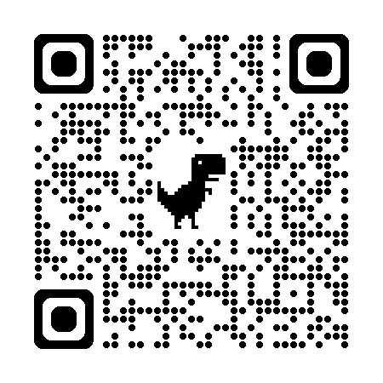
Violations of Match Policy
Section 11.0 Violations
“Programs are expected to conduct their affairs in an ethical, professional, and responsible manner.
At its discretion, the NRMP is authorized to investigate alleged violations for reasons including but not limited to:
Failure to provide complete, timely, and accurate information during the interview, and the matching processes;
Failure to engage in ethical and/or professionally responsible behavior;
Attempts to subvert or circumvent eligibility requirements or the matching process, and improper communication."
Violations Policy
Reproduction of slides and data prohibited without permission from the NRMP
Notes:
There also are times when the NRMP receives notices of alleged Match policy violations by programs. The SMS Match Agreement for Programs references violations in Section 11.0, and the QR code on the screen will take you to the Violations Policy, which outlines the robust investigative and reporting actions taken by the NRMP and the range of sanctions the NRMP is authorized to levy.

Slide 28
Violations – Process
Alleged violation reported to NRMP.
NRMP reviews the alleged violation to determine if an investigation is warranted. If so:
Information requested by NRMP from all relevant parties
Preliminary Report prepared and reviewed by parties
Case file and draft Panel Report prepared
Case file forwarded to members of Policy Review Committee for adjudication.
If violation confirmed:
Review Panel Report issued to subject of investigation
Arbitration consideration period extended to subject
Final Report distributed.
Reproduction of slides and data prohibited without permission from the NRMP
Notes:
When an alleged violation of policy is reported to the NRMP, the procedures outlined here are used to conduct an investigation.
If the subject of an investigation wishes to contest the findings outlined in the Review Panel Report, the case goes to arbitration and the sanctions are stayed pending the outcome of that arbitration.

Slide 29
Violations – Notification
The NRMP is authorized to send copies of the Final Disposition for a confirmed violation to a range of parties, included but not limited to
The NRMP institutional official for transmittal to the institution’s graduate medical education committee
The chair of the institution’s graduate medical education committee
The ACGME for distribution to the respective Review Committee (RC)
The respective specialty program director association
The party who originally reported the violation
Any federal or state regulatory agency or private accreditation entity that may have enforcement authority over the matter
Reproduction of slides and data prohibited without permission from the NRMP
Notes:
For programs with confirmed violations of NRMP policies, the NRMP is authorized to send notice of final disposition to this list of entities, including but not limited to....

Slide 30
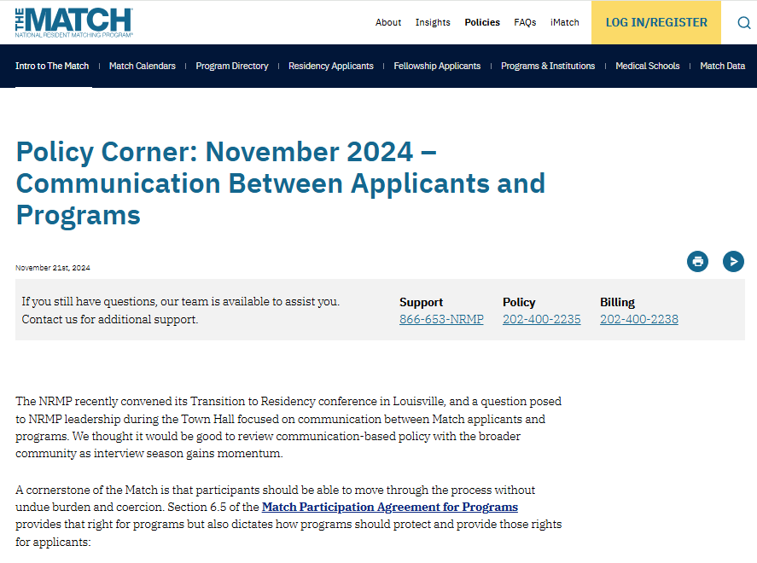
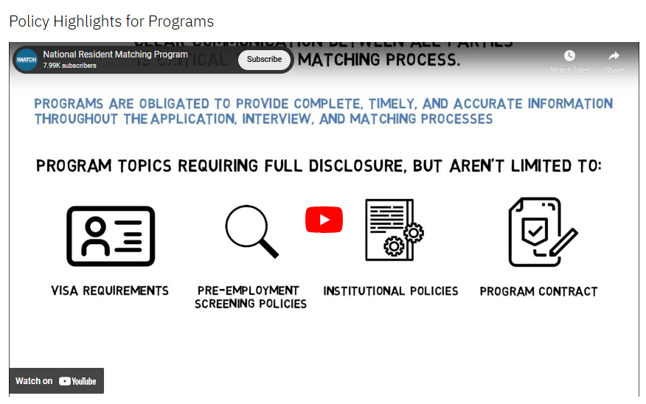
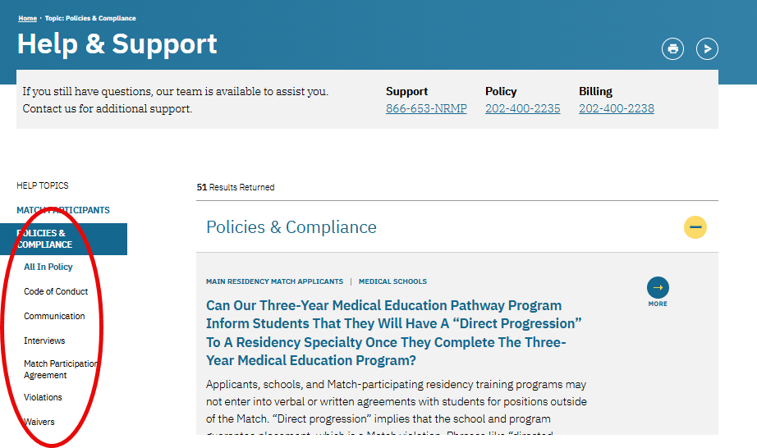
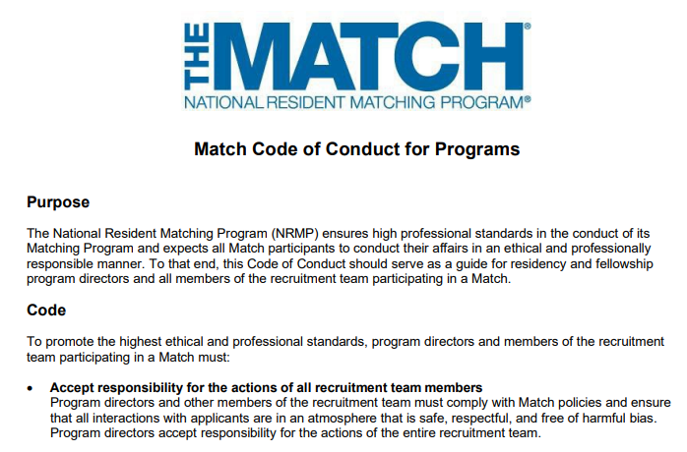
Policy Resources
Monthly “Policy Corner” Tips
Policy Videos
Codes of Conduct
FAQs
Reproduction of slides and data prohibited without permission from the NRMP
Notes:
So, what is available to help you learn and navigate Match policies?
We have many resources to help programs and institutions, most of which are found on the NRMP website. They include…
These resources offer helpful insights, guidance, and answers to common questions and needs of participants. We hope you’ll take some time to review, and you can always reach out with questions.

Slide 31
Why Policy Matters
New Policies/Process for SMS 2025
Policy Refreshers
Bumps in the Road
Updates and Goings-On
Q&A
Reproduction of slides and data prohibited without permission from the NRMP
Notes:
Our last section today covers updates and goings-on at the NRMP that might help or inform your Match experience, and for that I’ll turn it back over to Laurie.

Slide 32
Match Fees
Changes to Fellowship Match fees will roll out in 2025 and continue through 2027:
2025 Fellowship Matches opening after June 30, 2025, the new fees will be:
Institution Registration Fee: $300 per Match
Program Registration Fee: $100 per program track
Per Applicant Matched to Program Fee: $75 per applicant
2026 Fellowship Matches opening after Jan 1, 2026, the “Per Applicant Matched to a Program Fee” will transition to a “Certified Positions Fee.” Institutions will be invoiced based on each programs’ certified positions in a Match rather than each applicant successfully matched to a program.
2027 Fellowship Matches opening after Jan 1, 2027, the “Certified Positions Fee” will increase from $75 to $85 per certified position. Institution and Program Registration Fees will remain the same.
Reproduction of slides and data prohibited without permission from the NRMP
Notes:
We want to both remind you of fee changes coming in 2025 but also to share with you some additional changes that will roll out for fellowship matches in 2026 and 2027.
For Fellowship Matches opening after June 30, 2025, the new fee structure will be:
Institution Registration Fee: $300 per Match (currently $250)
Program Registration Fee: $100 per program track (currently $60)
Per Applicant Matched to Program Fee: $75 per applicant (currently $60)
For Matches opening after Jan 1 2026, the NRMP will pivot from a per applicant matched to a program fee to a certified positions fee. Read Slide
For Matches opening after Jan 1 2027, the certified positions fee will increase $10 dollars.

Slide 33
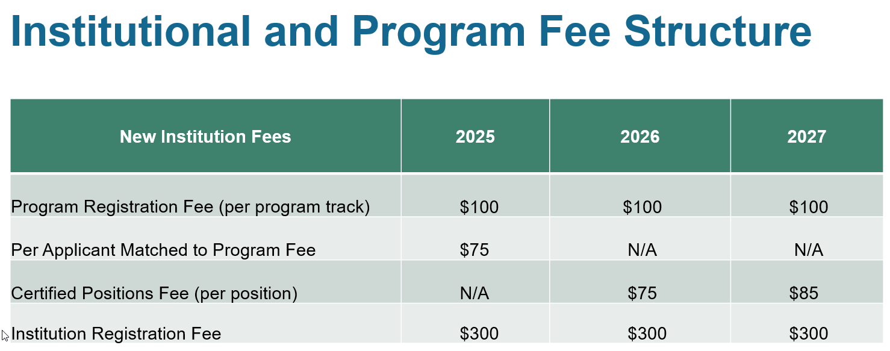
Match Fees
First increase in institution/program fees since 2018
Reproduction of slides and data prohibited without permission from the NRMP
Notes:
The table here showcases the changes that were just presented. There will no changes to the billing/invoice structure or process currently utilized by the NRMP.
The NRMP Board of Directors approved the changes in fees to support the variety of initiatives and enhancements NRMP is taking on to improve or inform the matching process as part of the transition to residency and fellowship. Fee increases for institutions and programs have not occurred since 2018. More messaging will be going out about the changes before the end of the year so institutions and programs can consider budget plans.

Slide 34
Vetting of Trainees for the Veterans Affairs (VA)
The Department of Veterans Affairs is enhancing its security posture by strengthening credential and vetting practices per Federal guidelines.
In addition to the fingerprint and law enforcement Special Agreement Check (SAC), which will still be required, Health Professions Trainees will be subject to additional suitability checks that vary based on citizenship status.
Reproduction of slides and data prohibited without permission from the NRMP
Notes:
Another topic we want to make sure you are aware of is the change to the vetting process of all residents/fellows who train or rotate through the VA In short...(read the slide)

Slide 35
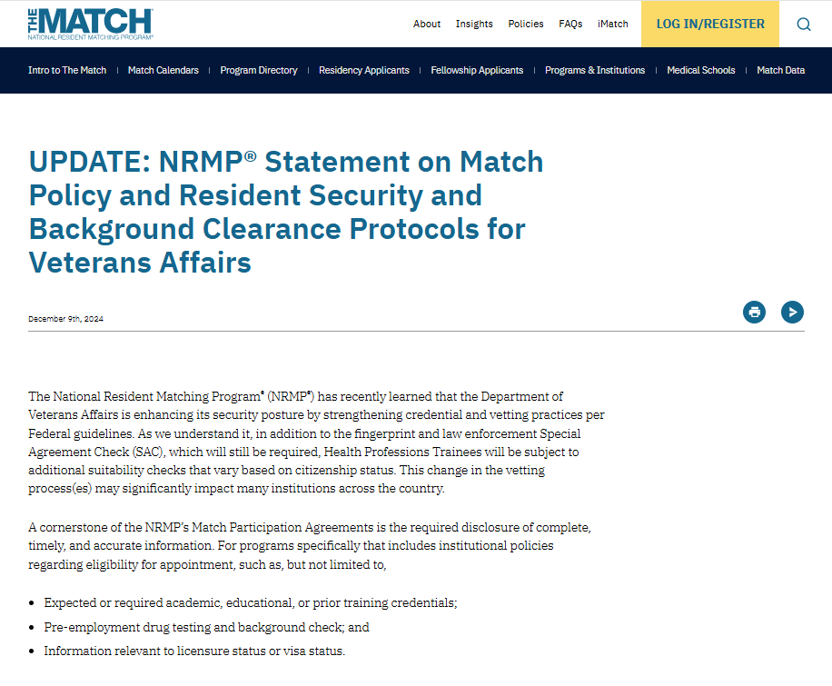
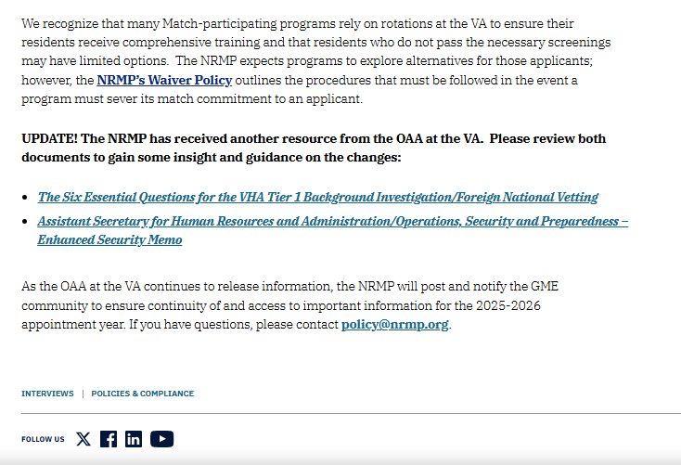
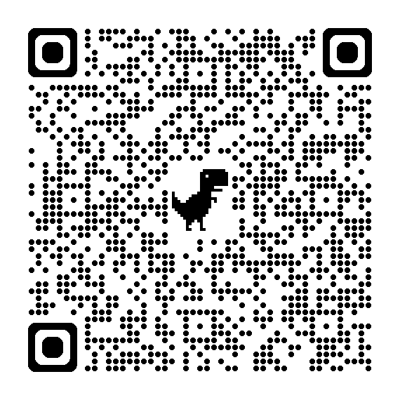
VA Screening
Reproduction of slides and data prohibited without permission from the NRMP
Notes:
This QR code will take you to the statement on the NRMP’s website that outlines the information we have about the vetting changes, reminders about Match policy and obligation of programs with VA affiliations to inform interviewed applicants of the change. The statement also has two resources from the Office of Academic Affiliations at the VA that provide additional guidance and offer answers to some commonly asked questions.
If you have questions, please email us at policy@nrmp.org. This is not a NRMP policy but one we will continue to monitor and provide updates to the GME community as we receive them.

Slide 36
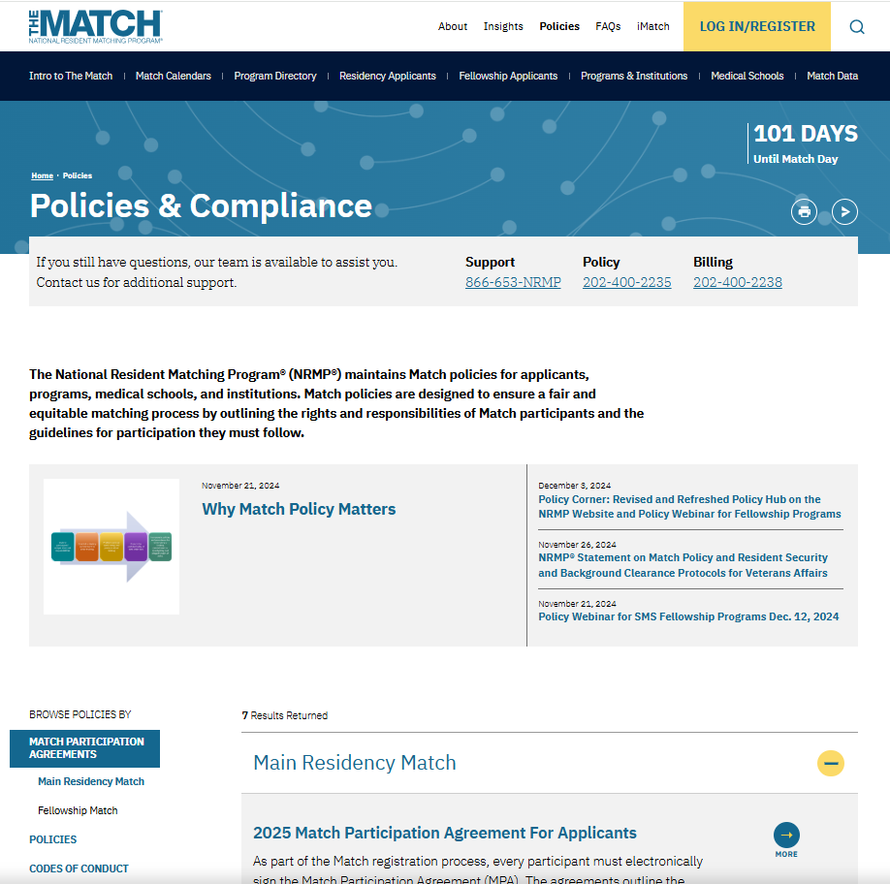
New Look for Policy!
Curated content to engage in timely education and outreach
Left filter option to quickly identify topics of interest
Targeted headers to reflect the range of NRMP data offerings
Reproduction of slides and data prohibited without permission from the NRMP
Notes:
Lastly, we are pleased to share our updated Policies webpage with you. With easier-to-identify left menu bar options, featuring targeted headers, as well as a content block at the top of the page that allows us to bring you curated resources for just-in-time match processes, we hope you find it easier to navigate to find topics of interest and helpful resources. Be sure to check it out!

Slide 37
Questions?
Reproduction of slides and data prohibited without permission from the NRMP

Slide 38
THANK YOU!
CONNECT WITH US
Location
455 Massachusetts Avenue, Suite 310, Washington, DC 20001
Phone
866.653.NRMP
Email
policy@nrmp.org
Website
www.nrmp.org/policies
Reproduction of slides and data prohibited without permission from the NRMP
Notes:
That is all the time we have for questions today. Thank you for joining us for this webinar. Please feel free to contact us if you need assistance and good luck in your Matches!

